Slide 1
Ampli Bioreactor

Slide 2
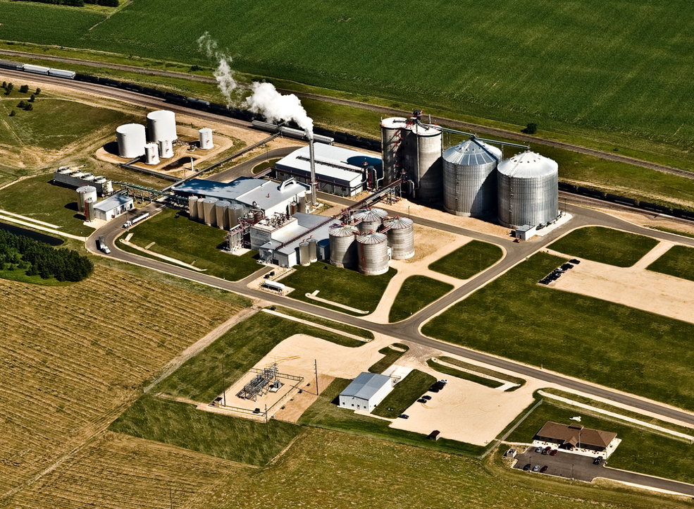
Introduction to Modern Day Bioreactors

Slide 3
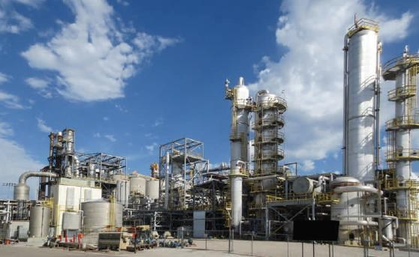
Ethanol plants seem complicated! What does everything do? What are all the tanks for?

Slide 4
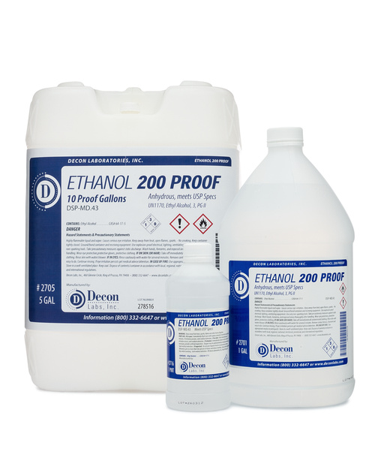
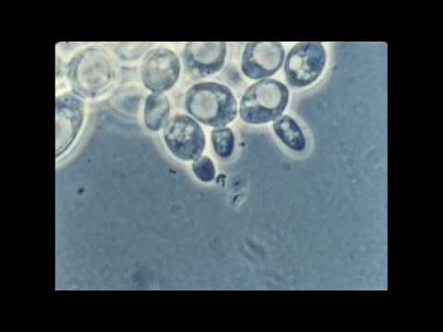
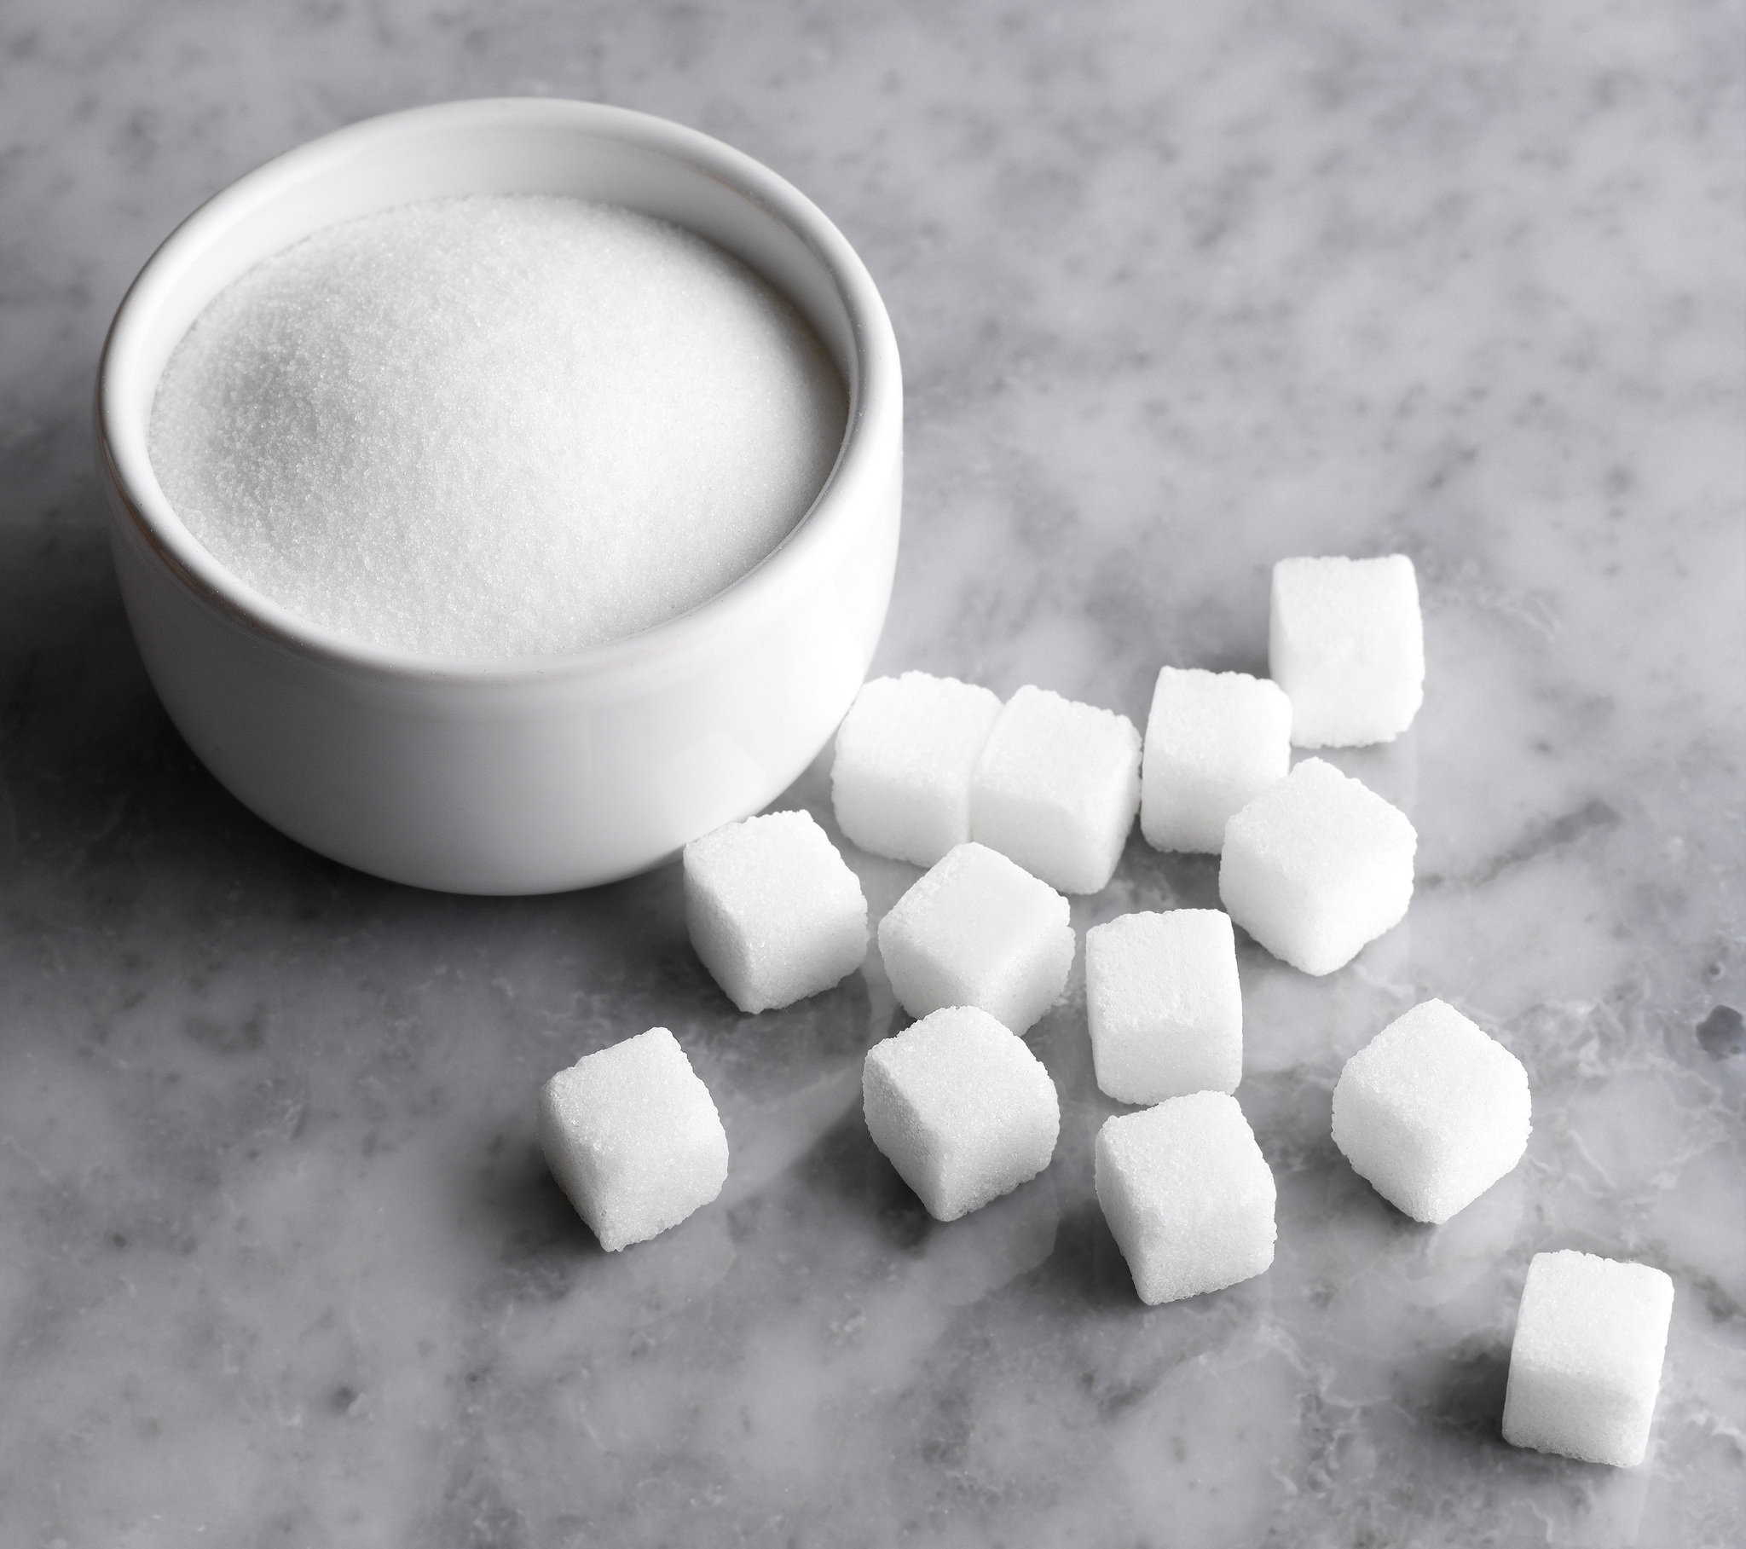
eat
Yeast
Sugar
to create
Ethanol

Slide 5
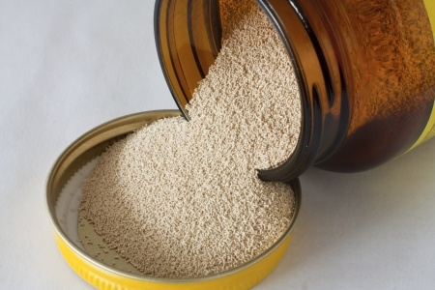
Yeast
Teacher: Hand out yeast packets for manipulation

Slide 6
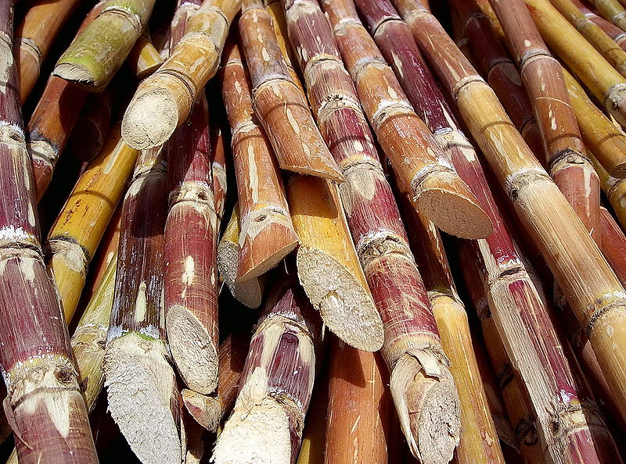
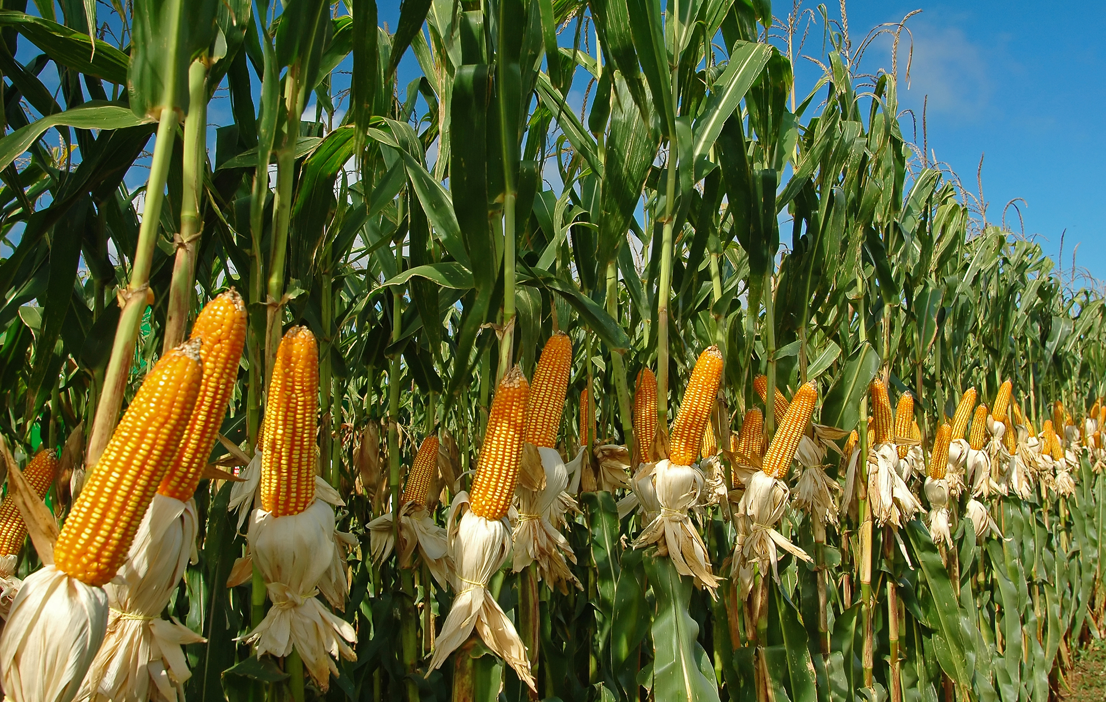
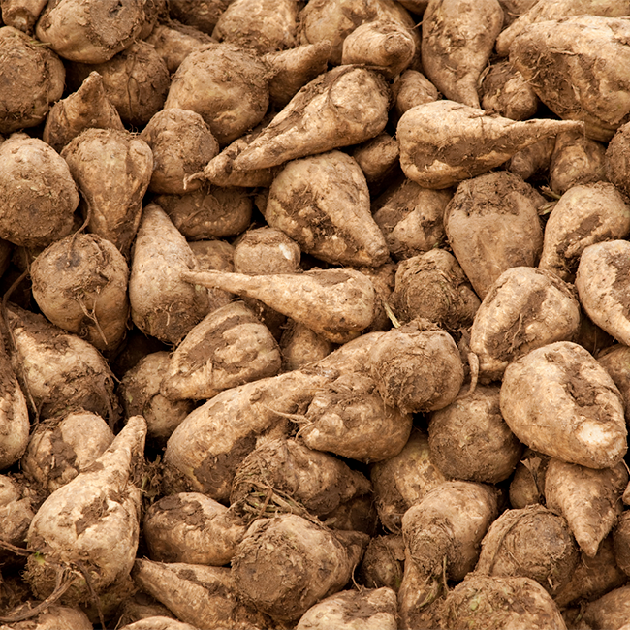
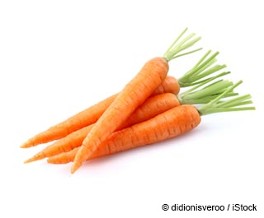
Sugar
Teacher: Where does sugar come from? What else has sugar?

Slide 7
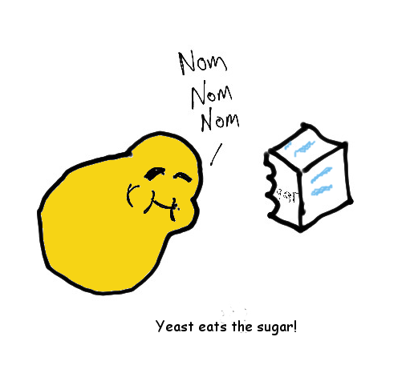
Teacher: When yeast eat sugar, we call that fermentation and it can produce useful products

Slide 8
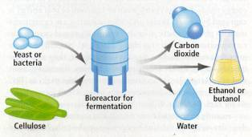
Teacher: In a typical plant, we need to connect the fermentation tanks, with other tanks that collect useful products

Slide 9
Ampli Bioreactor
Advanced Level

Slide 10
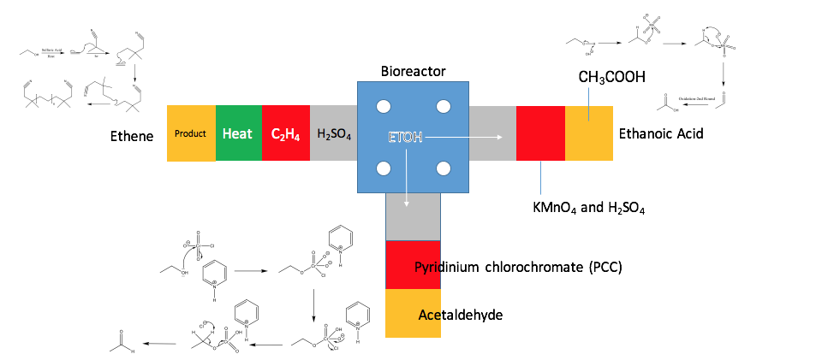

Slide 11
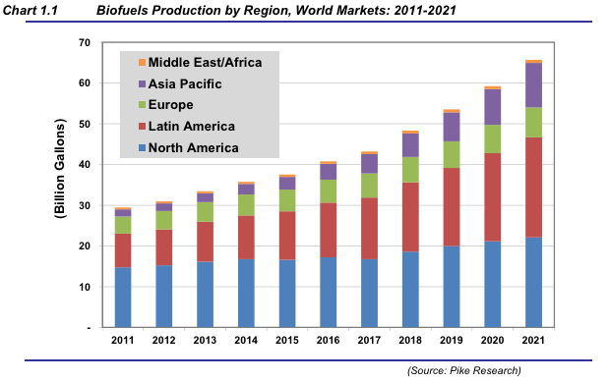
Global Biofuel Production with Projections to 2021

Slide 12
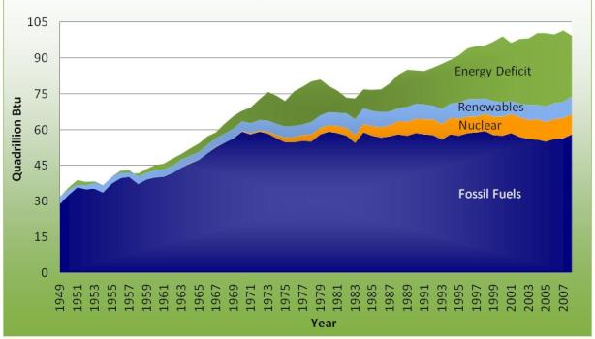
United States: Energy Use, Production, and Deficits

Slide 13
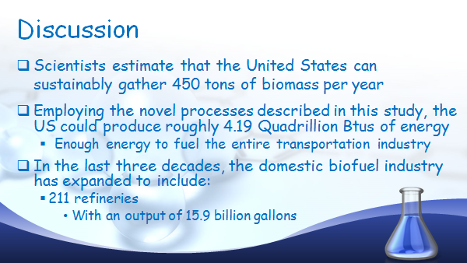

Slide 14

Reduce Greenhouse Gases

Slide 15

Save Time

Slide 16
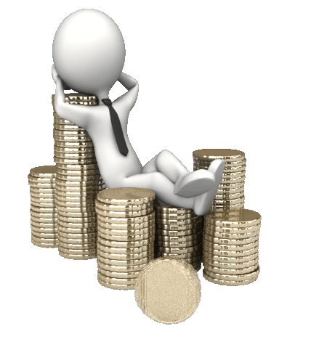
Save Money

